Slide 1
A Seminar on QuillBot: A Generative Approach for Q&A Automation
Team 11 -
1.Vishwas(20EG105411)
2.Abhinav(20EG105426)
3.Sai Chaitanya(20EG105437)
Project Supervisor
B. Ravinder Reddy
Assistant professor

Slide 2
Introduction
Our project mainly focuses on enhancing traditional question and answer interactions using Generative AI​
This is basically an educational platform created for university level students as all courses aren't available in other platforms.​
This model uses textbook data provided by user rather than Wikidata (Wikipedia data).​
Question and answer can be generated for desired courses.​
Our approach relies on Large Language Models (LLMs), Natural Language Processing (NLP), and the Generative Pre-trained Transformer (GPT).​
Our system seamlessly integrates these technologies, creating a robust architecture for understanding and responding to user queries.​

Slide 3
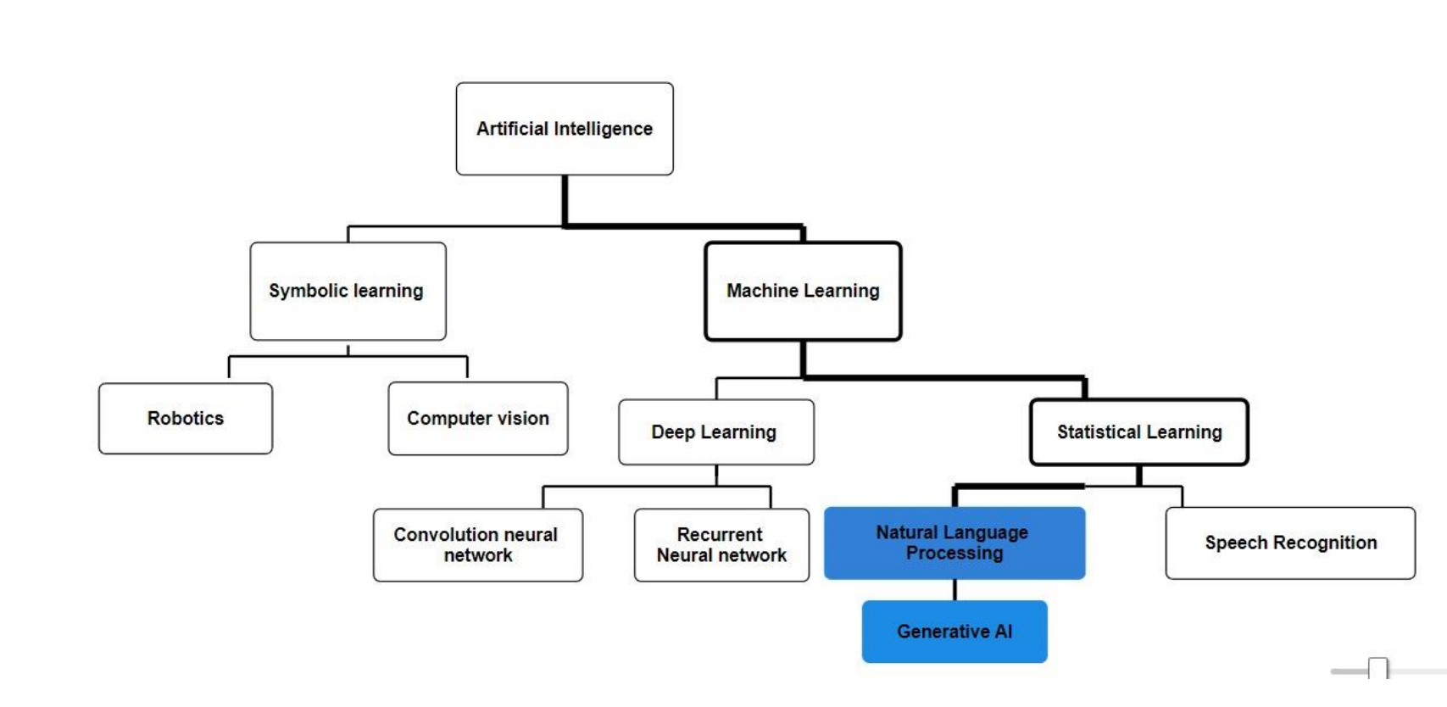
Concept Tree

Slide 4
Literature
Strategies | Advantages | Disadvantages
Automatic Question Generation from Wiki data Tail Entity Definition Based on Wiki data | Diverse Long-Tail QA. Automatic Dataset Generation | Dependency on External Resources
The question generation system used in this paper is called ProphetNet to generate a set of questions based on answer spans found in the passage. | Human-like Reasoning. Prevents the system from making unreliable guesses on questions | May need greater computational resources
Step by step processing, Smart Questioning and Scoreboard check | Multi-Meaning Question Generation. Step-by-Step for Strength. | Complexity. Input Quality Sensitivity
Template-Based Approaches. Machine Learning algorithms. | Scalability, Adaptability and Time Efficiency | Lack of creativity..OverReliance on Templates.
Wrong Answers Trickery | Time saver. Consistency. | Tricky Context. Can’t rely too much

Slide 5
Literature
Authors | Strategies | Advantages | Disadvantages
Rohan Kumar Youngmin kim | LLM and Chatgpt -3 | Reducing the manual effort involved in constructing diverse datasets | Ambiguity in Entity and Property Recognition
Shivani G.Aithal, Abishek B.Rao Sanjay Singh. | BERT, Pr-ophetNet | Avoiding Unanswerable Questions. | Less computer resources potentially leading to slower processing times
Ms. Khushbu,Khandait Dr. S.A Bhura, Dr. S.S Asole | DistilGPT2 SQUAD | Can measure using Standard metrics.(BLUE , METEOR) | Potential for the system to become too specific to train data, limiting adaptability
Nithya M Madavaraj B Sanjeev Pranesh B | NLP OCR(python library) | Customization and Consistence | Context Understanding
Puneeth Thotad Shanta Kallur Sukanya Amminabhavi | SpaCy Natural Language Processing Toolkit. | Quick Response. Good accuracy. | Computers struggle to be creative like humans. Questions might sound a bit robotic.

Slide 6
Problem Statement
The existing algorithm uses the longtail knowledge that is the wikideta (Wikipedia data) to answer the users queries and also there are other algorithms which does the open domain question answering but the problem arises when it comes to the educational use case where the student as a user cannot accurately retrieve the answers from the gpt models because of the lack of text-book that is theoretical knowledge present. So, as to overcome this problem we came up with a solution where we powered our QuillBot with the latest algorithm which searches the given knowledge base and retrieves the answers for the students query.

Slide 7
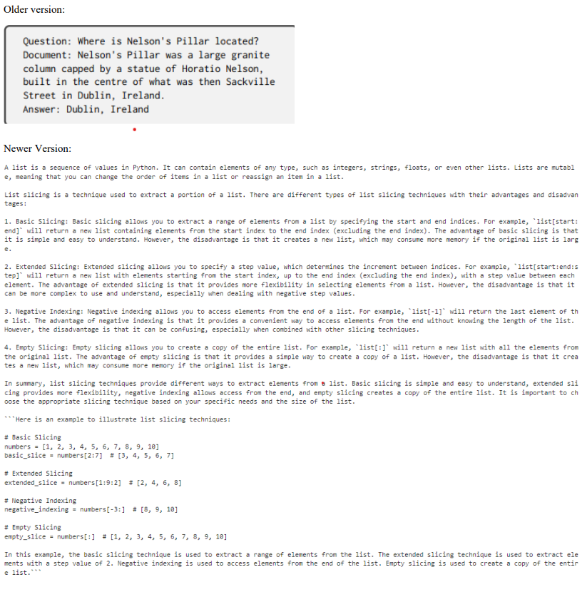
Problem Illustration
Let's denote:
P as the given passage.
Q as the input question.
The task is to design a model M such that M(P,Q) returns the answer to the question Q based on the information in the passage P.
M(P,Q)→Answer

Slide 8
Proposed Method
Meet Quillbot, my brainchild! It's not just your average question-answering AI. Forget clunky rule-based systems - Quillbot harnesses the power of both GPT's fluency and Langchain's meticulous fact-checking. Imagine a generative AI that understands context, seamlessly blends factual accuracy with natural language, and even learns from every interaction. That's Quillbot - your friendly, knowledge-powered conversationalist, ready to tackle any query with insightful answers and a dash of AI magic.
Beyond the impressive parameters of Langchain and GPT, Quillbot's true magic lies in its focus on student needs. While these existing algorithms excel at navigating the vast oceans of general knowledge like Wikipedia's depths, they often flounder when it comes to the specific shores of your textbook. Quillbot bridges this gap. It dives deep into your assigned materials, understanding the context and nuances of your subject. Langchain's knowledge chains become intricate pathways through your textbook's concepts, while GPT's fluency translates them into clear, subject-relevant answers. Every interaction strengthens Quillbot's grasp of your curriculum, tailoring its responses to your specific learning journey. Forget generic summaries and lost connections – Quillbot becomes your personalized study buddy, unlocking the power of your textbooks and guiding you towards deeper understanding.

Slide 9
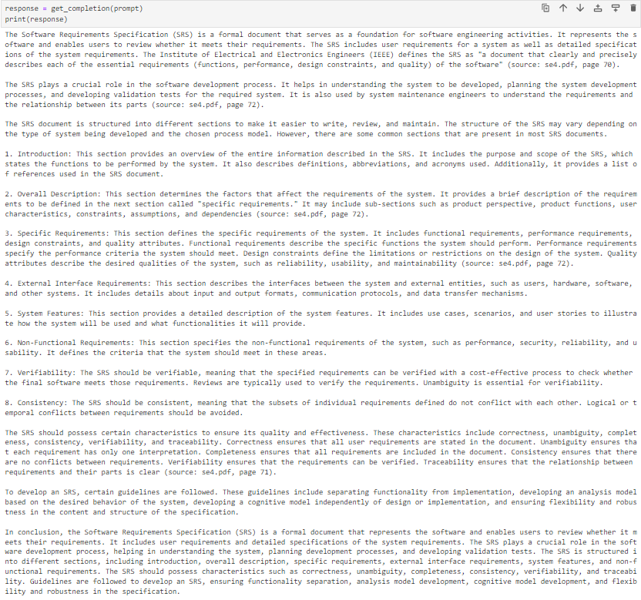
Proposed Method Illustration
Let:
- Q be the user's question.
- T be the set of textbooks in PDF format.
- M be your GPT model.
Input Processing:
Q is the user's question.
Textbook Analysis:
Identify relevant sections in textbooks:
S=MarkRelevantSections(T,Q)
Knowledge Retrieval:
Extract information from textbooks using GPT: I=ExtractInformation(M,S,Q)
Answer Generation:
Synthesize answers:
A=GenerateAnswer(M,I)
User Interaction:
Present the generated answer: Output=PresentAnswer(A)

Slide 10
Parameter
Accuracy:
Exact Match Accuracy: The percentage of questions for which the model's answer is an exact match to the ground truth.
Precision, Recall, and F1 Score:
Precision: The ratio of correctly predicted positive observations to the total predicted positives.
Recall: The ratio of correctly predicted positive observations to the all observations in the actual class.
F1 Score: The weighted average of precision and recall. It is a balance between precision and recall.
BLEU Score:
BLEU (Bilingual Evaluation Understudy): Measures how many words and phrases in the model's answer overlap with a reference answer. Commonly used in machine translation, it can be adapted for Q&A.
ROUGE Score:
ROUGE (Recall-Oriented Understudy for Gisting Evaluation): Measures overlap in n-grams between the model's answer and reference answer. Useful for evaluating the quality of summaries or short texts.
EM (Entity Matching) Score:
Entity Matching Score: Measures how well the model identifies and matches entities (names, locations, dates, etc.) in the answer with those in the reference answer.

Slide 11
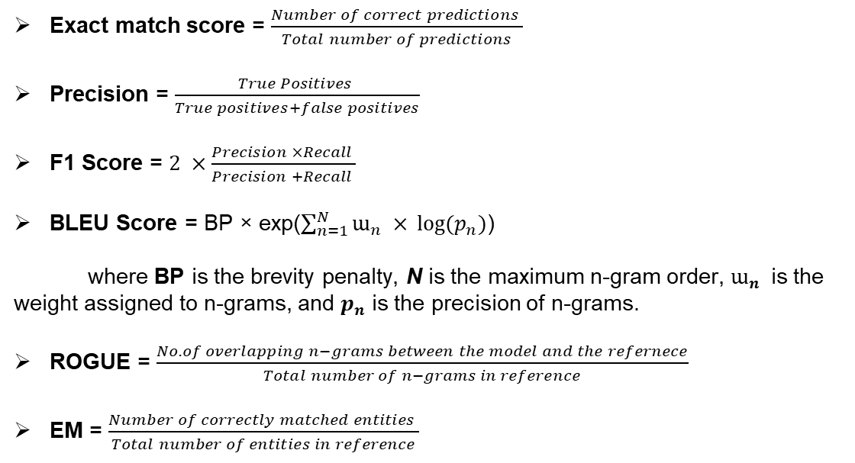
Parameter Formulas
Exact match score = $\frac{Number of correct predictions }{Total number of predictions}$
Precision = $\frac{True Positives }{True positives+false positives}$
F1 Score = $2 ×\frac{Precision ×Recall }{Precision +Recall }$
BLEU Score = BP × exp($\sum_{n=1}^{N}{ɯ_{n} ×} log⁡(p_{n})$)
where BP is the brevity penalty, N is the maximum n-gram order, $ɯ_{n}$ is the weight assigned to n-grams, and $p_{n}$ is the precision of n-grams.
ROGUE = $\frac{No. of overlapping n−grams between the model and the refernece}{Total number of n−grams in reference}$
EM = $\frac{Number of correctly matched entities }{Total number of entities in reference}$

Slide 12
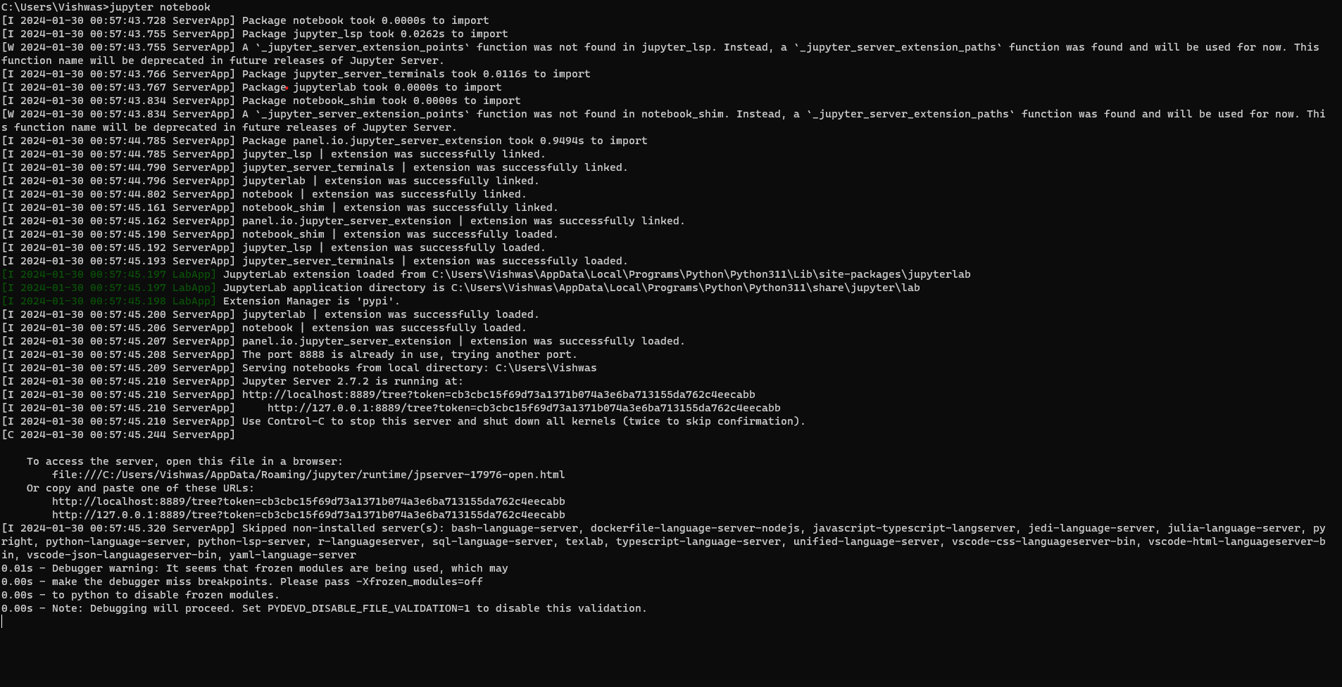
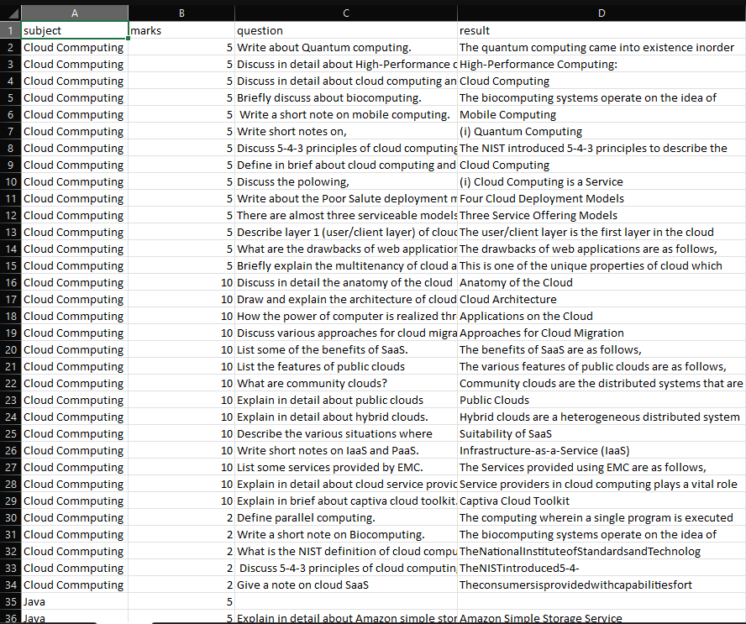
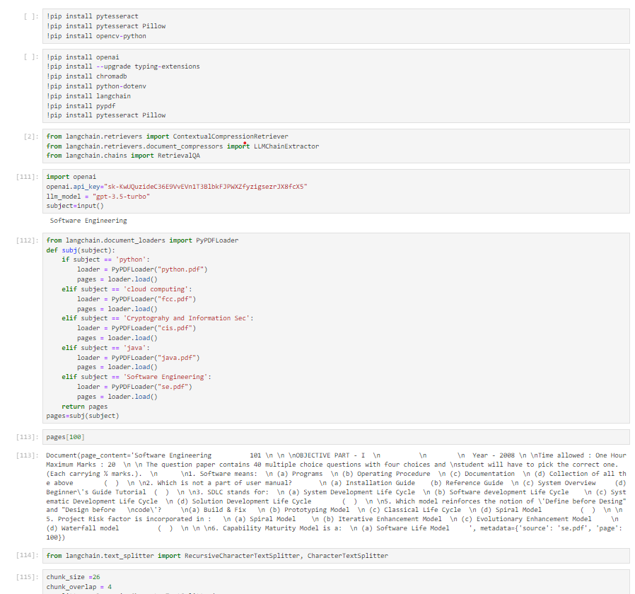
Experiment Environment
Tool: Jupyter Notebook
Language: Python
Dataset: csv – json line data set

Slide 13
Project status
S.No | Functionality | Status (Completed /in-progress/Not started)
1 | Pre-processing the data | Completed
2 | Llms evaluation | Completed
3 | Structuring the llms for retrieval of data | Completed
4 | Data structuring according to user needs | Completed
5 | Preparing dataset | In process
6 | Finetuning the AI model | Not-started
7 | Interface preparation | Not –started
8 | Backend integration to the mode | Not - started

Slide 14
References
[1] Rohan Kumar, Youngmin Kim, Sunitha Ravi, KnowledgeNLP-KDD’23, August 07, 2023, Long Beach, CA
[2] Shivani G. Aithal · Abishek B. Rao · Sanjay Singh Accepted: 11 March 2021 / Published online: 7 April 2021 © The Author(s) 2021
[3] Ms Khusbhu Khandait , Dr S S Bhura , Dr S S Asole et al./ Indian Journal of Computer Science and Engineering(IJCSE)
[4] Nithya M , Madavaraj B, Sanjeev Pranesh B, Kruthikaran V, Volume 7, Issue 10, October – 2022 International Journal of Innovative Science and Research Technology
[5] Puneeth Thotad , Shanta Kallur , Sukanya Amminabhavi , Journal of Pharmaceutical Negative Results ¦ Volume 13 ¦
Special Issue 10 ¦ 2022

Slide 15

Thank you

